Slide 1
Public-Key Cryptography

Slide 2
Why Public-Key Cryptography?
developed to address two key issues:
  key distribution – how to have secure communications in general without having to trust a KDC with your key
  digital signatures – how to verify a message comes intact from the claimed sender
Public key schemes, and 1st practical scheme, which was for key distribution only, was published in 1976 by Whitfield Diffie & Martin Hellman at Stanford Uni
  known earlier in classified community
Notes:
The concept of public-key cryptography evolved from an attempt to attack two of the most difficult problems associated with symmetric encryption: key distribution and digital signatures. The first problem is that of key distribution, which under symmetric encryption requires either (1) that two communicants already share a key, which somehow has been distributed to them; or (2) the use of a key distribution center. This seemed to negated the very essence of cryptography: the ability to maintain total secrecy over your own communication. The second was that of "digital signatures." If the use of cryptography was to become widespread, not just in military situations but for commercial and private purposes, then electronic messages and documents would need the equivalent of signatures used in paper documents.
The idea of public key schemes, and the first practical scheme, which was for key distribution only, was published in 1976 by Diffie & Hellman. The concept had been previously described in a classified report in 1970 by James Ellis (UK CESG) - and subsequently declassified [ELLI99]. Its interesting to note that they discovered RSA first, then Diffie-Hellman, opposite to the order of public discovery! There is also a claim that the NSA knew of the concept in the mid-60’s [SIMM93].

Slide 3
Public-Key Cryptography Principles
The use of two keys has consequences in: key distribution, confidentiality and authentication.
The scheme has six ingredients (see Figure (a))
  Plaintext
  Encryption algorithm
  Public and private key
  Ciphertext
  Decryption algorithm

Slide 4
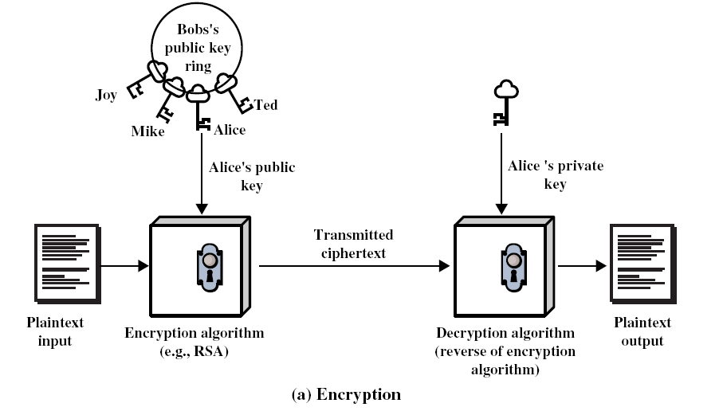
Encryption using Public-Key system

Slide 5
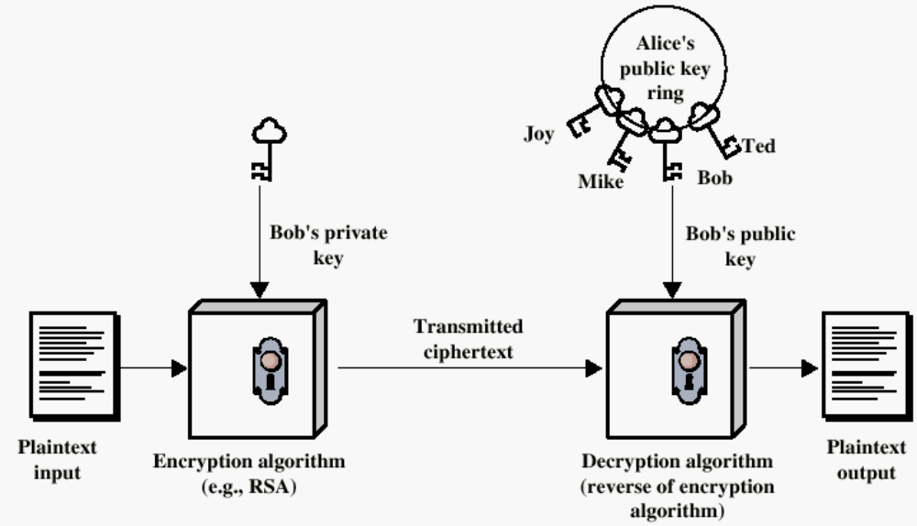
Authentication using Public-Key System
Henric Johnson

Slide 6
Applications for Public-Key Cryptosystems
Three categories:
  Encryption/decryption: The sender encrypts a message with the recipient’s public key.
  Digital signature: The sender ”signs” a message with its private key.
  Key exchange: Two sides cooperate to exhange a session key.

Slide 7
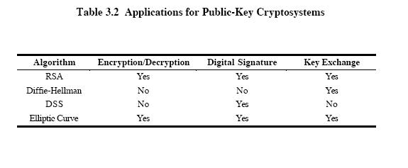

Slide 8
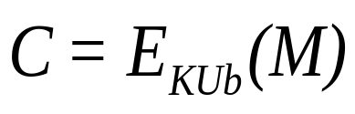
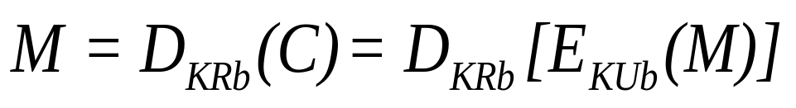
Requirements for Public-Key Cryptography
Computationally easy for a party B to generate a pair (public key KUb, private key KR_{b})
Easy for sender to generate ciphertext:
Easy for the receiver to decrypt ciphertect using private key:

Slide 9
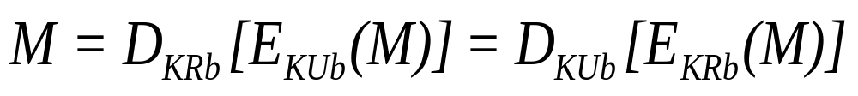
Requirements for Public-Key Cryptography (contd.)
Computationally infeasible to determine private key (KR_{b}) without knowing public key (KU_{b})
Computationally infeasible to recover message M, knowing KU_{b} and ciphertext C
Either of the two keys can be used for encryption, with the other used for decryption:

Slide 10
Public-Key Cryptographic Algorithms
RSA and Diffie-Hellman
RSA - Ron Rivest, Adi Shamir and Len Adleman at MIT, in 1977.
  RSA is a block cipher
  The most widely implemented
Diffie-Hellman
  Echange a secret key securely
  Compute discrete logarithms

Slide 11
RSA Algorithm
C = Me mod (n=pq)
Plaintext: M
Ciphertext: C
M= C^{d} mod n
Encryption
Plaintext: M<n
Ciphertext: C = Me (mod n)
Decryption
Ciphertext: C
Plaintext: M = C^{d} (mod n)

Slide 12
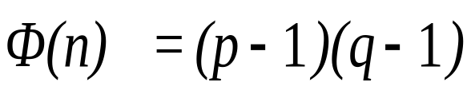
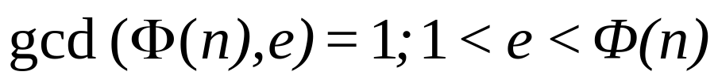
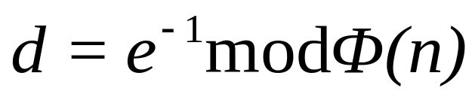
The RSA Algorithm – Key Generation
Select p,q p and q both prime
Calculate n = p x q
Calculate
Select integer e
Calculate d
Public Key KU = {e,n}
Private key KR = {d,n}

Slide 13
RSA Algorithm Example
Choose p = 3 and q = 11
Compute n = p * q = 3 * 11 = 33
Compute φ(n) = (p - 1) * (q - 1) = 2 * 10 = 20
Choose e such that 1 < e < φ(n) and e and n are coprime. Let e = 7
Compute a value for d such that (d * e) % φ(n) = 1. One solution is d = 3 [(3 * 7) % 20 = 1]
Public key is (e, n) => (7, 33)
Private key is (d, n) => (3, 33)
The encryption of m = 2 is c = 2⁷ % 33 = 29
The decryption of c = 29 is m = 29³ % 33 = 2
Class Exercise: Work with p=17, q= 11

Slide 14
RSA Example - Key Setup
Select primes: p=17 & q=11
Calculate n = pq =17 x 11=187
Calculate ø(n)=(p–1)(q-1)=16x10=160
Select e: gcd(e,160)=1; choose e=7
Determine d: de mod 160 and d < 160 Value is d=23 since 23x7=161
and 161 mod 160 = 1
  Publish public key PU={7,187}
  Keep secret private key PR={23,187}
Notes:
Stallings provides an example of RSA key generation using “trivial” sized numbers.
Selecting primes requires the use of a primality test.
Finding d as inverse of e mod ø(n) requires use of Euclid’s Inverse algorithm (see Ch4)

Slide 15
RSA Example - En/Decryption
sample RSA encryption/decryption is:
given message M = 88 (nb. 88<187)
encryption:
  C = 88⁷ mod 187 = 11
decryption:
  M = 11²³ mod 187 = 88
Notes:
Then show that the encryption and decryption operations are simple exponentiations mod 187.
Rather than having to laborious repeatedly multiply, can use the "square and multiply" algorithm with modulo reductions to implement all exponentiations quickly and efficiently (see next).

Slide 16
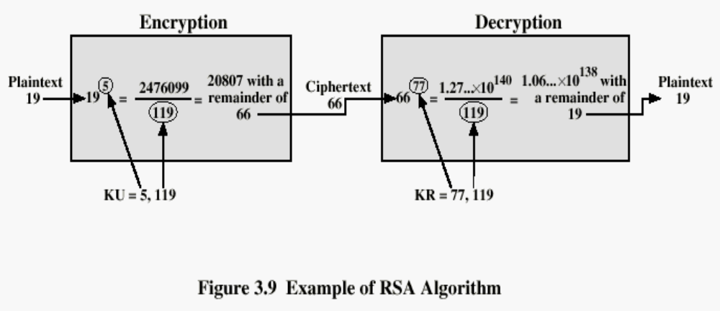
2nd Example of RSA Algorithm
What are p and q values in this case?

Slide 17
Diffie-Hellman Key Exchange
a public-key distribution scheme
  cannot be used to exchange an arbitrary message
  rather it can establish a common key
  known only to the two participants
value of key depends on the participants (and their private and public key information)
based on exponentiation in a finite (Galois) field (modulo a prime or a polynomial) – easy
security relies on the difficulty of computing discrete logarithms (similar to factoring) – hard

Slide 18
Diffie-Hellman Setup
all users agree on global parameters:
  large prime integer or polynomial q
  α a primitive root mod q
each user (eg. A) generates their key
  chooses a secret key (number): x_{A} < q
  compute their public key: y_{A} = α^{xA} mod q
each user makes public that key y_{A}
Notes:
The prime q and primitive root α can be common to all using some instance of the D-H scheme. Note that the primitive root α is a number whose powers successively generate all the elements mod q. Alice and Bob choose random secrets x's, and then "protect" them using exponentiation to create the y's. For an attacker monitoring the exchange of the y's to recover either of the x's, they'd need to solve the discrete logarithm problem, which is hard.

Slide 19
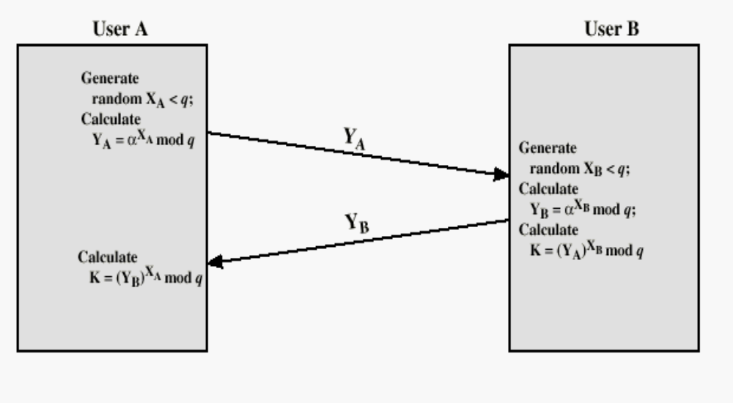
Diffie-Hellman Key Exchange
Henric Johnson

Slide 20
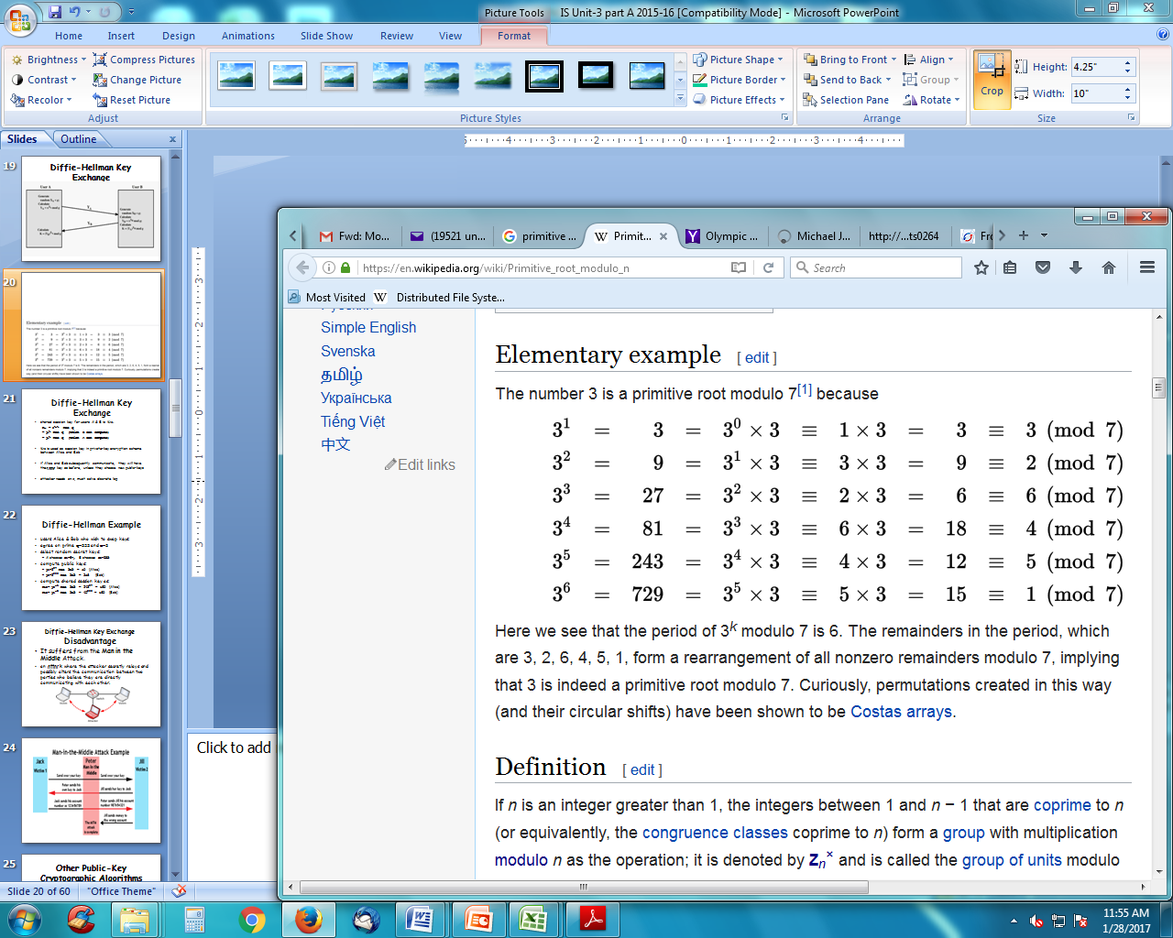
Primitive Root of a Prime Number - Example

Slide 21
Diffie-Hellman Key Exchange
shared session key for users A & B is K_{AB}:
  K_{AB} = α^{xA.xB} mod q
  = y_{A}^{xB} mod q (which B can compute)
  = y_{B}^{xA} mod q (which A can compute)
K_{AB} is used as session key in private-key encryption scheme between Alice and Bob
if Alice and Bob subsequently communicate, they will have the same key as before, unless they choose new public-keys
attacker needs an x, must solve discrete log
Notes:
The actual key exchange for either party consists of raising the others "public key' to power of their private key. The resulting number (or as much of as is necessary) is used as the key for a block cipher or other private key scheme. For an attacker to obtain the same value they need at least one of the secret numbers, which means solving a discrete log, which is computationally infeasible given large enough numbers

Slide 22
Diffie-Hellman Example
users Alice & Bob who wish to swap keys:
agree on prime q=353 and α=3
select random secret keys:
  A chooses x_{A}=97, B chooses x_{B}=233
compute public keys:
  y_{A}=3⁹⁷ mod 353 = 40 (Alice)
  y_{B}=3²³³ mod 353 = 248 (Bob)
compute shared session key as:
  K_{AB}= y_{B}^{xA} mod 353 = 248⁹⁷ = 160 (Alice)
  K_{AB}= y_{A}^{xB} mod 353 = 40²³³ = 160 (Bob)

Slide 23
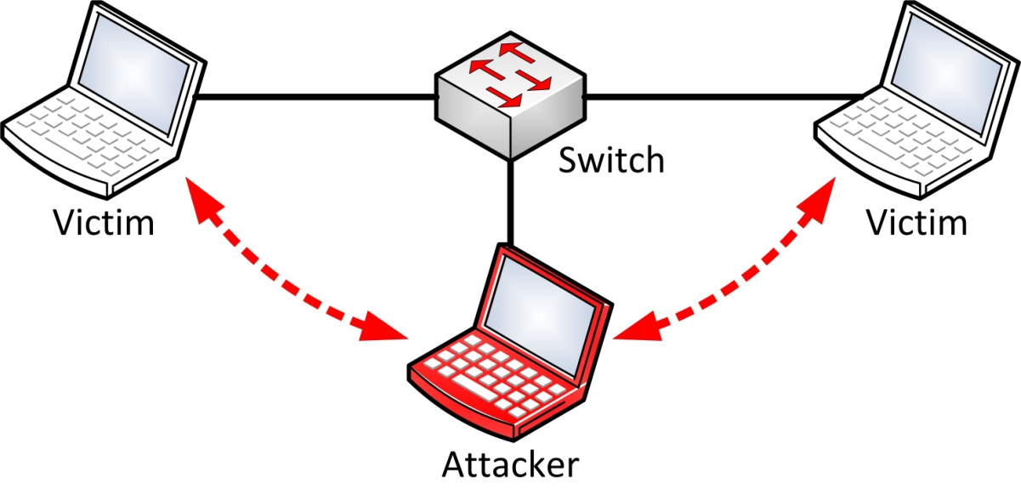
Diffie-Hellman Key Exchange Disadvantage
It suffers from the Man in the Middle Attack.
an attack where the attacker secretly relays and possibly alters the communication between two parties who believe they are directly communicating with each other.
Henric Johnson

Slide 24
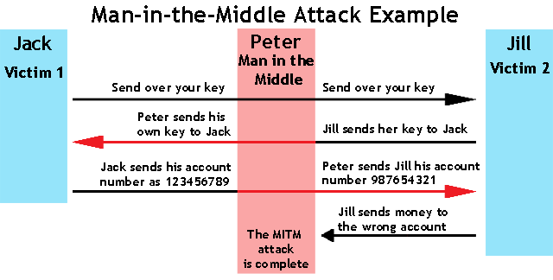
Henric Johnson

Slide 25
Other Public-Key Cryptographic Algorithms
Digital Signature Standard (DSS)
  Makes use of the SHA-1
  Not for encryption or key exchange
Elliptic-Curve Cryptography (ECC)
  Good for smaller bit size
  Low confidence level, compared with RSA
  Very complex

Slide 26
Key Management
public-key encryption helps address key distribution problems
have two aspects of this:
  distribution of public keys
  use of public-key encryption to distribute secret keys
Notes:
One of the major roles of public-key encryption has been to address the problem of key distribution, with two distinct aspects: the distribution of public keys, and the use of public-key encryption to distribute secret keys.

Slide 27
Distribution of Public Keys
can be considered as using one of:
  public announcement
  publicly available directory
  public-key authority
  public-key certificates
Notes:
Several techniques have been proposed for the distribution of public keys, which can mostly be grouped into the categories shown.

Slide 28
1. Public Announcement
users distribute public keys to recipients or broadcast to community at large
  eg. Append keys to email messages or post to news groups or email list
major weakness is forgery
  anyone can create a key claiming to be someone else and broadcast it
  until forgery is discovered can masquerade as claimed user
Notes:
The point of public-key encryption is that the public key is public, hence any participant can send his or her public key to any other participant, or broadcast the key to the community at large. Its major weakness is forgery, anyone can create a key claiming to be someone else and broadcast it, and until the forgery is discovered they can masquerade as the claimed user.

Slide 29
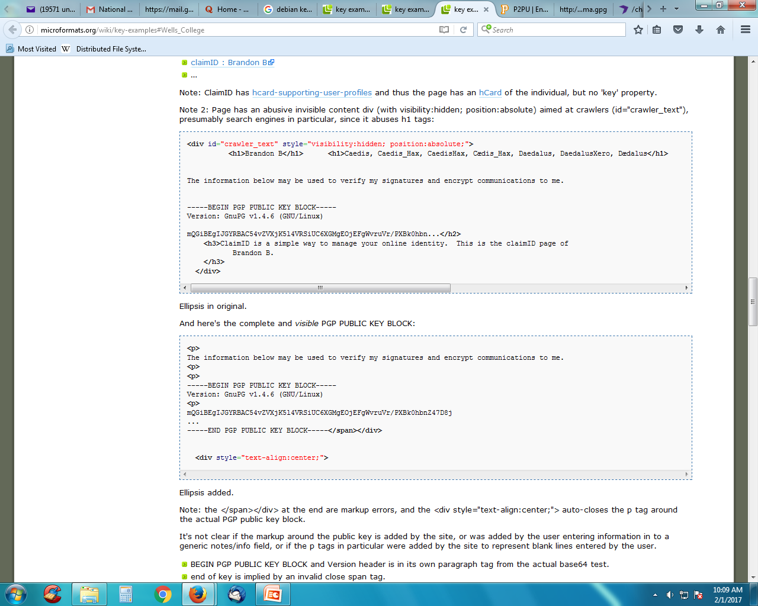
Example
Henric Johnson

Slide 30
2. Publicly Available Directory
can obtain greater security by registering keys with a public directory
directory must be trusted with properties:
  contains {name,public-key} entries
  participants register securely with directory
  participants can replace key at any time
  directory is periodically published
  directory can be accessed electronically
still vulnerable to tampering or forgery
Notes:
A greater degree of security can be achieved by maintaining a publicly available dynamic directory of public keys. Maintenance and distribution of the public directory would have to be the responsibility of some trusted entity or organization. This scheme is clearly more secure than individual public announcements but still has vulnerabilities to tampering or forgery.

Slide 31
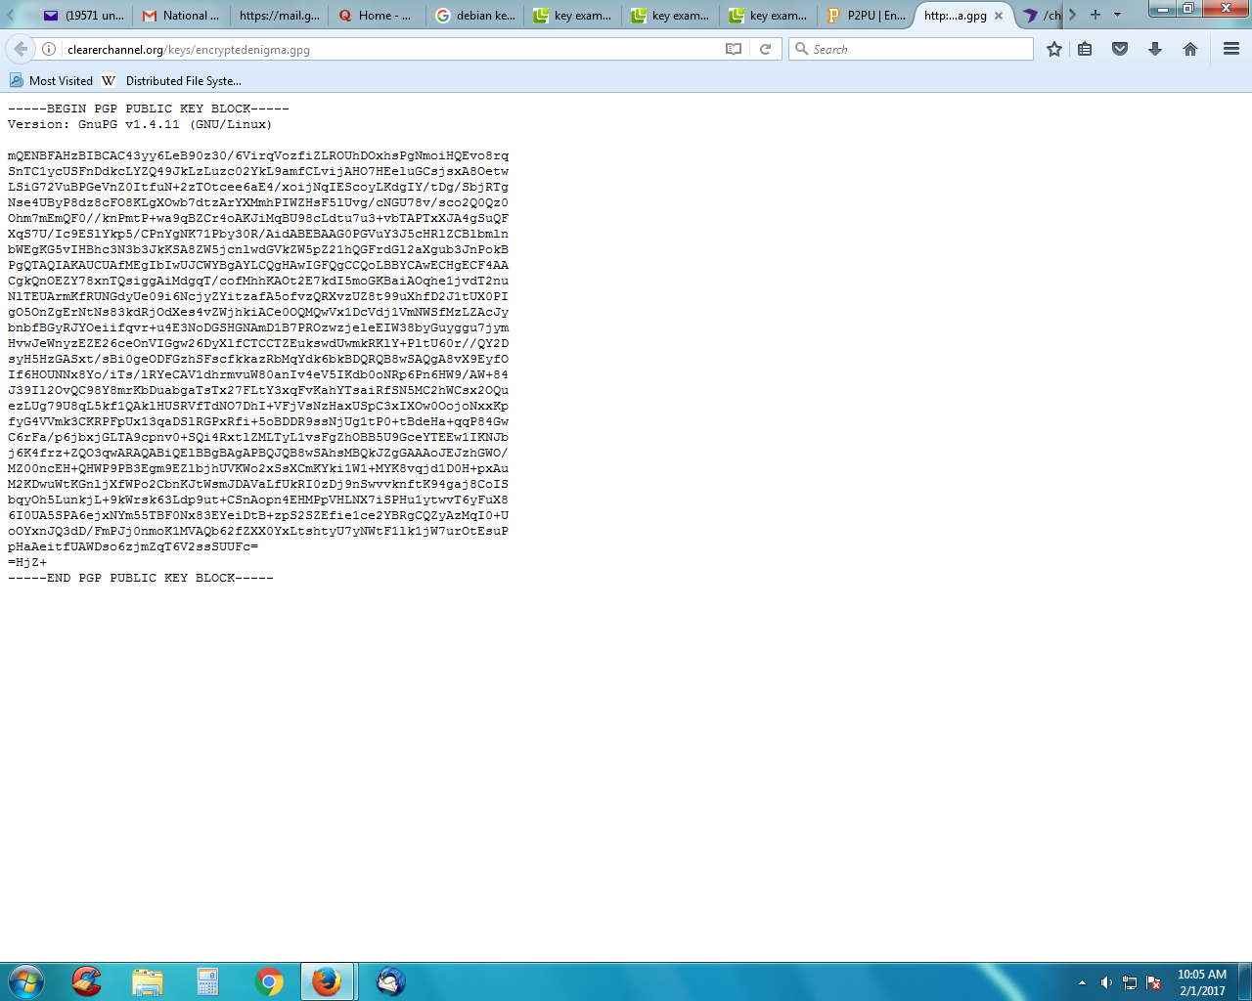
Example
Henric Johnson

Slide 32
Public-Key Authority
improve security by tightening control over distribution of keys from directory
has properties of directory
and requires users to know public key for the directory
then users interact with directory to obtain any desired public key securely
  does require real-time access to directory when keys are needed
Notes:
Stronger security for public-key distribution can be achieved by providing tighter control over the distribution of public keys from the directory. It requires users to know the public key for the directory, and that they interact with directory in real-time to obtain any desired public key securely. Note that a total of seven messages are required, as shown next.

Slide 33
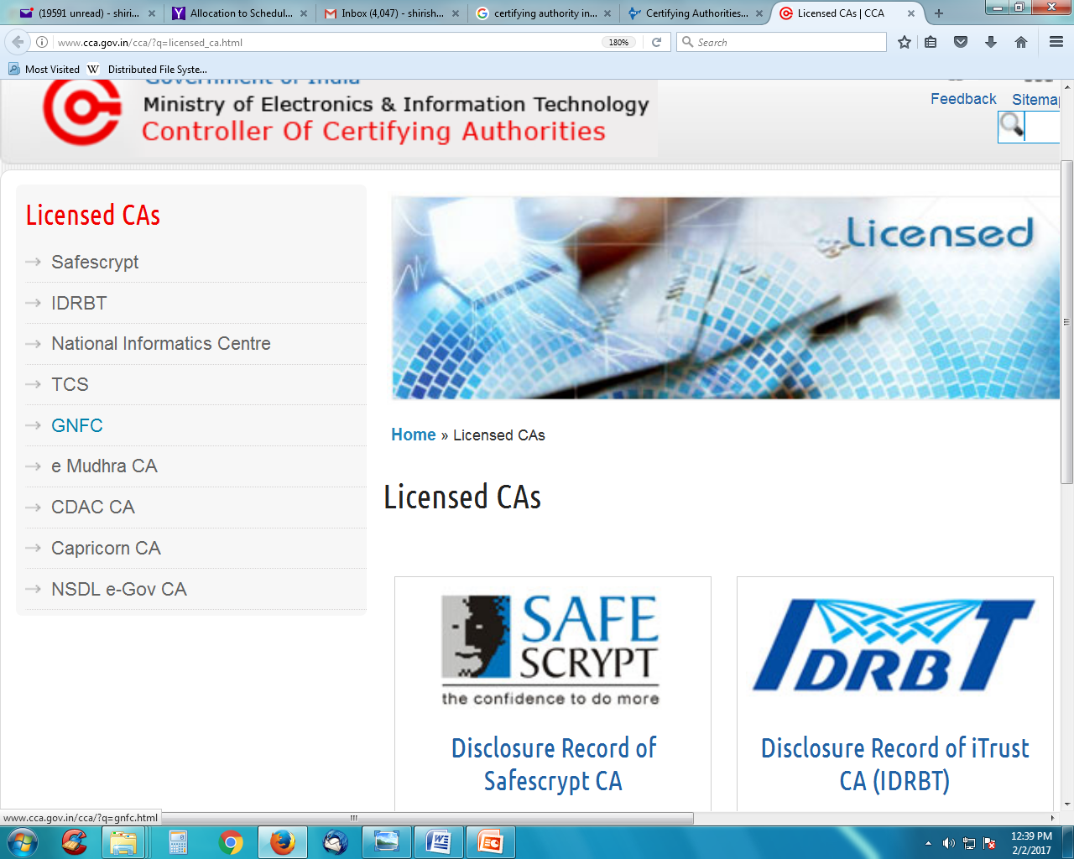
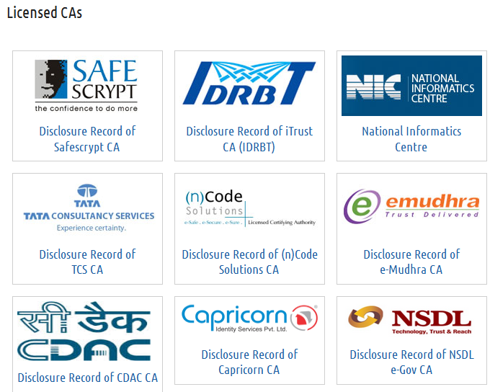
CAs in India
Henric Johnson

Slide 34
Public-Key Certificates
certificates allow key exchange without real-time access to public-key authority
a certificate binds identity to public key
  usually with other info such as period of validity, rights of use etc
with all contents signed by a trusted Public-Key or Certificate Authority (CA)
can be verified by anyone who knows the public-key authorities public-key
Notes:
An further improvement is to use certificates, which can be used to exchange keys without contacting a public-key authority, in a way that is as reliable as if the keys were obtained directly from a public-key authority. A certificate binds an identity to public key, with all contents signed by a trusted Public-Key or Certificate Authority (CA). This can be verified by anyone who knows the public-key authorities public-key.
One scheme has become universally accepted for formatting public-key certificates: the X.509 standard. X.509 certificates are used in most network security applications, including IP security, secure sockets layer (SSL), secure electronic transactions (SET), and S/MIME. Will discuss it in much more detail later.

Slide 35
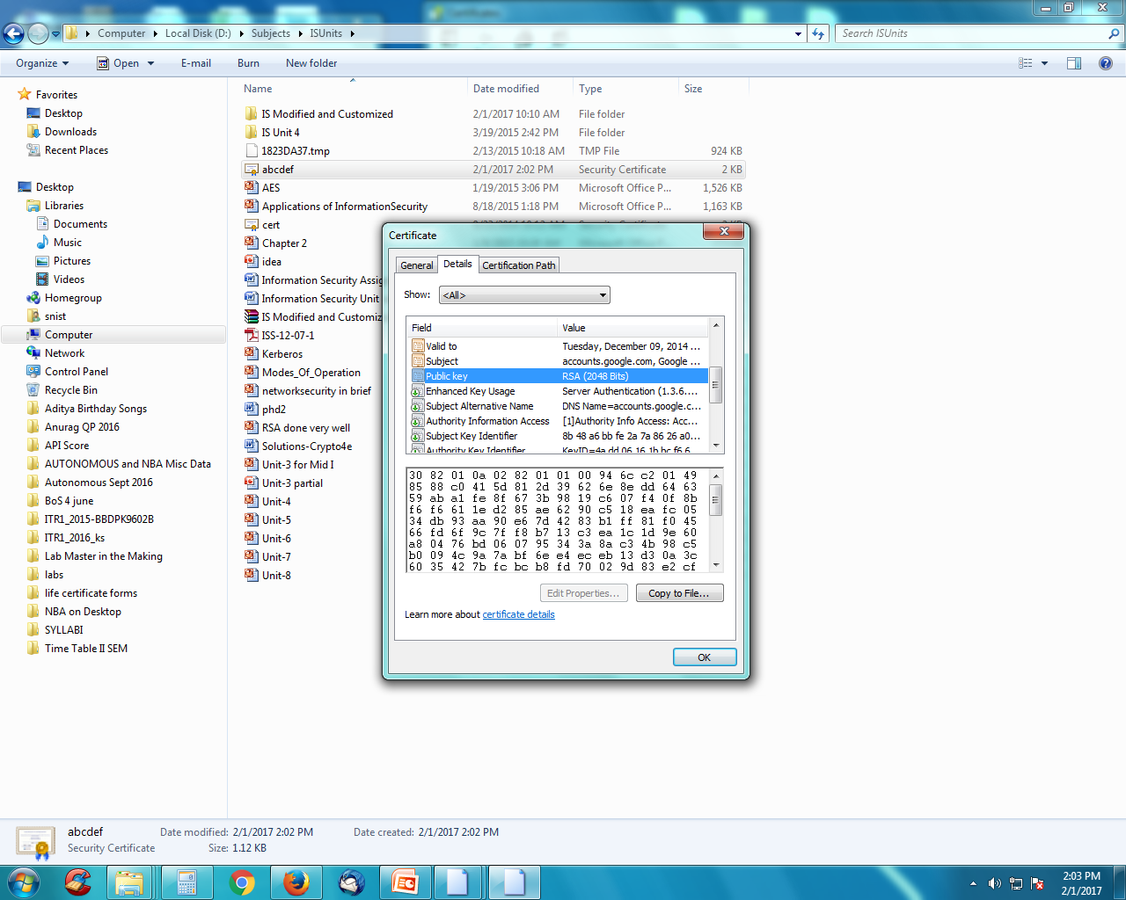
Example
Henric Johnson

Slide 36
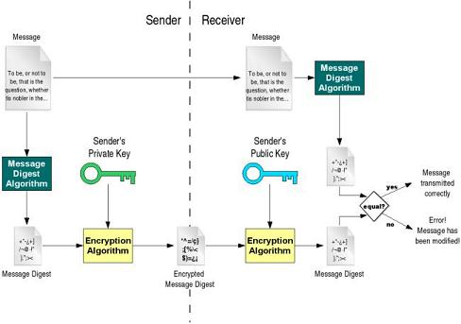
Key Management:
Public-Key Certificate Use
Henric Johnson

Slide 37
Public-Key Distribution of Secret Keys
use previous methods to obtain public-key
can use for secrecy or authentication
but public-key algorithms are slow
so usually want to use private-key encryption to protect message contents
hence need a session key
have several alternatives for negotiating a suitable session
Notes:
Once public keys have been distributed or have become accessible, secure communication that thwarts eavesdropping, tampering, or both, is possible. However, few users will wish to make exclusive use of public-key encryption for communication because of the relatively slow data rates that can be achieved. Accordingly, public-key encryption provides for the distribution of secret keys to be used for conventional encryption.

Slide 38
Security Concerns
key concerns are confidentiality and timeliness
to provide confidentiality must encrypt identification and session key info
which requires the use of previously shared private or public keys
need timeliness to prevent replay attacks
provided by using sequence numbers or timestamps or challenge/response

Slide 39
KERBEROS
What?
  Computer network authentication protocol
How?
  Works on the basis of 'tickets'
  Why?
    Allow nodes communicating over a non-secure network to prove their identity to one another in a secure manner.
Users wish to access services on servers.
Three threats exist:
  User pretend to be another user.
  User alter the network address of a workstation.
  User eavesdrop on exchanges and use a replay attack.

Slide 40
KERBEROS
Provides a centralized Authentication Server to authenticate users to servers and servers to users.
Relies on conventional encryption, making no use of public-key encryption
Two versions: version 4 and 5
Version 4 makes use of DES

Slide 41
Kerberos Requirements
its first report identified requirements as:
  transparent
  reliable
  scalable
  secure
implemented using an authentication protocol based on Needham-Schroeder
Notes:
In a more open environment, in which network connections to other machines are supported, an approach that requires the user to prove his or her identity for each service invoked, and also require that servers prove their identity to clients, is needed to protect user information and resources housed at the server. Kerberos supports this approach, and assumes a distributed client/server architecture that employs one or more Kerberos servers to provide an authentication service. The first published report on Kerberos [STEI88] listed the following requirements:
• Secure: A network eavesdropper should not be able to obtain the necessary information to impersonate a user. More generally, Kerberos should be strong enough that a potential opponent does not find it to be the weak link.
• Reliable: For all services that rely on Kerberos for access control, lack of availability of the Kerberos service means lack of availability of the supported services. Hence, Kerberos should be highly reliable and should employ a distributed server architecture, with one system able to back up another.
• Transparent: Ideally, the user should not be aware that authentication is taking place, beyond the requirement to enter a password.
• Scalable: The system should be capable of supporting large numbers of clients and servers. This suggests a modular, distributed architecture.
To support these requirements, Kerberos is a trusted third-party authentication service that uses a protocol based on that proposed by Needham and Schroeder which was discussed earlier in this chapter.

Slide 42
Kerberos Version 4
Terms:
  C = Client
  AS = authentication server
  V = server
  IDc = identifier of user on C
  IDv = identifier of V
  P_{c} = password of user on C
  ADc = network address of C
  Kv = secret encryption key shared by AS and V
  TS = timestamp
  || = concatenation
Henric Johnson

Slide 43
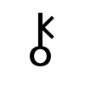
A Simple Authentication Dialogue
C  AS: IDc || P_{c} || IDv
AS  C: Ticket
C  V: IDc || Ticket
Ticket = E_{Kv}[IDc || AD_{c} || IDv]
AS
C: Client
CW: Client Workstation
AS: Authentication Server
AS_{DB}: AS database
V: File Server
F: File
_{Kv: Key known only to AS and V}
IDc || P_{c} || IDv
AS_{DB}
Ticket
C
_{Kv}
CW
IDc || Ticket
V
F
Requested file
_{Kv}

Slide 44
Disadvantagesin the Authentication Dialogue
AS
IDc || P_{c} || IDv1
AS_{DB}
C
Ticket1
_{Kv1}
CW
IDc || Ticket1
V1
F
Requested file
_{Kv1}
Requested mail
V2
IDc || Ticket2
Mail Server
_{Kv2}
Problems:
    As password is sent as plaintext, hackers may get hold of it and use illegally.
  2. For different server, different ticket is to be obtained by the client.

Slide 45
Overcoming Problems in Kerberos v4:
Password not to be sent to AS
Introduce new sever: Ticket Granting server (TGS)
Overview
a basic third-party authentication scheme
have an Authentication Server (AS)
  users initially negotiate with AS to identify self
  AS provides a non-corruptible authentication credential (ticket granting ticket TGT)
have a Ticket Granting server (TGS)
  users subsequently request access to other services from TGS on basis of users TGT
using a complex protocol using DES
Notes:
The core of Kerberos is the Authentication and Ticket Granting Servers – these are trusted by all users and servers and must be securely administered. The protocol includes a sequence of interactions between the client, AS, TGT and desired server. Version 4 of Kerberos makes use of DES, in a rather elaborate protocol, to provide the authentication service. Viewing the protocol as a whole, it can be difficult to see the need for the many elements contained therein. The text contains more detailed discussion about the development of and need for the components of the final v4 protocol.

Slide 46
A more secure Authentication Dialogue
User C wants Server V access
AS
AS_{DB}
E(K_{c}, Ticket_{tgs})
C
K_{tgs}
CW
*
IDc || ID_{v}||Ticket_{tgs}
TGS
*
K_{tgs}
Ticket_{v}
_{Kv}
Requested file
V
F
IDc || Ticket_{v}
_{Kv}
K_{c}=f(P_{c})
Ticket_{tgs}= E(K_{tgs,}[IDc || AD_{c}||ID_{tgs}||TS₁||Lifetime₁])
Ticket_{v}= E(K_{v,}[IDc || AD_{c}||ID_{v}||TS₂||Lifetime₂])

Slide 47
Problems with Version 4 Authentication Dialogue (mentioned in earlier slide)
Problems:
  Lifetime associated with the ticket-granting ticket
  If too short  repeatedly asked for password
    As password is sent as plaintext, hackers may get hold of it and use illegally.
  If too long  greater opportunity to replay
  The threat is that an opponent will steal the ticket and use it before it expires
  2. If opponent captures Ticket_{tgs} and uses it before it expires, the opponent has access to the corresponding service.
    Solution to this: So TGS must authenticate itself to the client so that client passes the request to the right TGS and not to false server.
    A session key K_{c,tgs} is passed secretly to Client and TGS by AS.

Slide 48
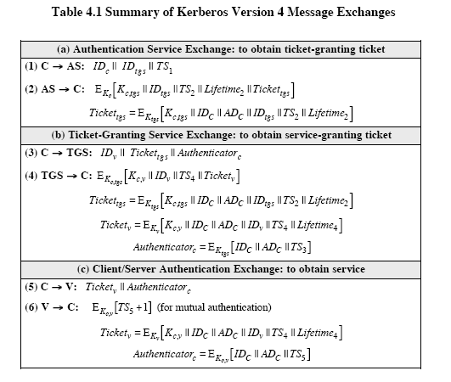
Version 4 Authentication Dialogue

Slide 49
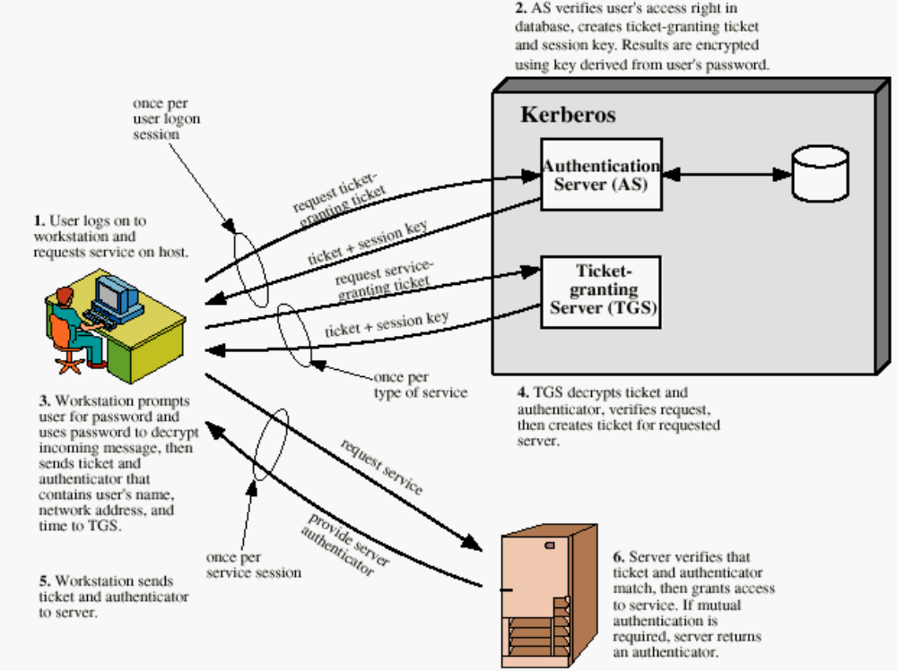
Overview of Kerberos
Henric Johnson

Slide 50
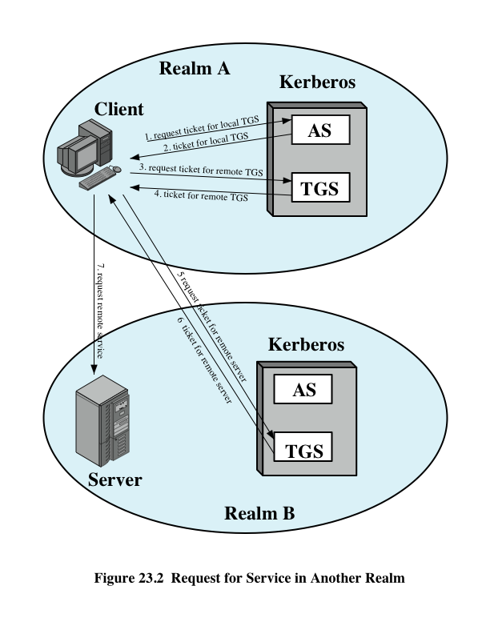
Request for Service in Another Realm

Slide 51
Message Exchange for Remote Realm Access
C→AS: ID_{c} || ID_{tgs} || TS₁
AS→C: E_{Kc}[K_{c,tgs} || ID_{tgs} || TS₂ || Lifetime₂ || Ticket_{tgs}]
C→TGS: ID_{tgsrem} || Ticket_{tgs} || Authenticator_{c}
TGS→C: E_{Kc,tgs}[K_{c,tgsrem} || ID_{tgsrem} || TS₄ || Ticket_{tgsrem}]
C→TGS_{rem}: ID_{vrem} || Ticket_{tgsrem} || Authenticator_{c}
TS→C: E_{Kc,tgsrem}[K_{c,vrem} || ID_{vrem} || TS₆ || Ticket_{vrem}]
C→V_{rem}: Ticket_{vrem} || Authenticator_{c}
The only problem with this exchange is that when there are many realms
There are too many key exchanges to different realms.

Slide 52
Difference Between Version 4 and 5
A. Environmental Shortcomings
Encryption system dependence (V.4 DES)
Internet protocol dependence
Message byte ordering
Ticket lifetime
Authentication forwarding
Interrealm authentication

Slide 53
Differences Between V4 and V5 …
B. Technical deficiencies
  Double encryption:
  PCBC encryption: Propagating CBC is used in V4 and this is non-standard. In V5 CBC is used.
  Session key: Each ticket includes a session key that can be used to encrypt the authenticator. Since the same key is used repeatedly to gain a service from particular server, there is a risk that an opponent can replay messages from an old session to the client or server. In V5 this is avoided by requiring a sub session key which is used only for one connection.

Slide 54
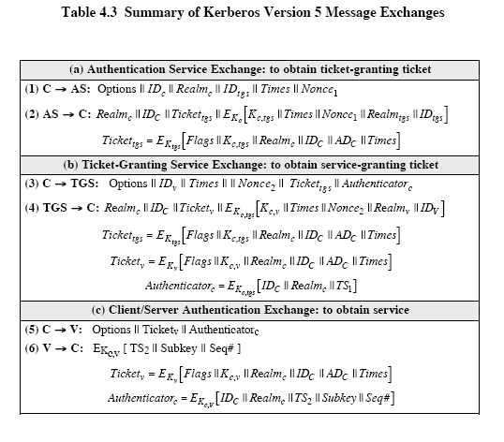
Version 5 Authentication Dialogue

Slide 55
X.509 Authentication Service
More broadly X.509 defines a framework to provide a secure directory services.
Distributed set of servers that maintains a database about users.
Each certificate contains the public key of a user and is signed with the private key of a CA.
Is used in S/MIME, IP Security, SSL/TLS and SET.
RSA is recommended to use

Slide 56
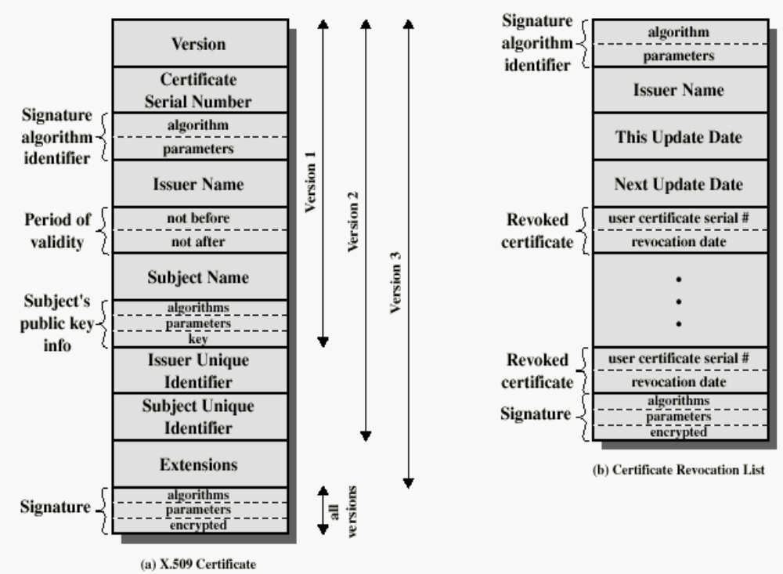
X.509 Formats
Henric Johnson

Slide 57
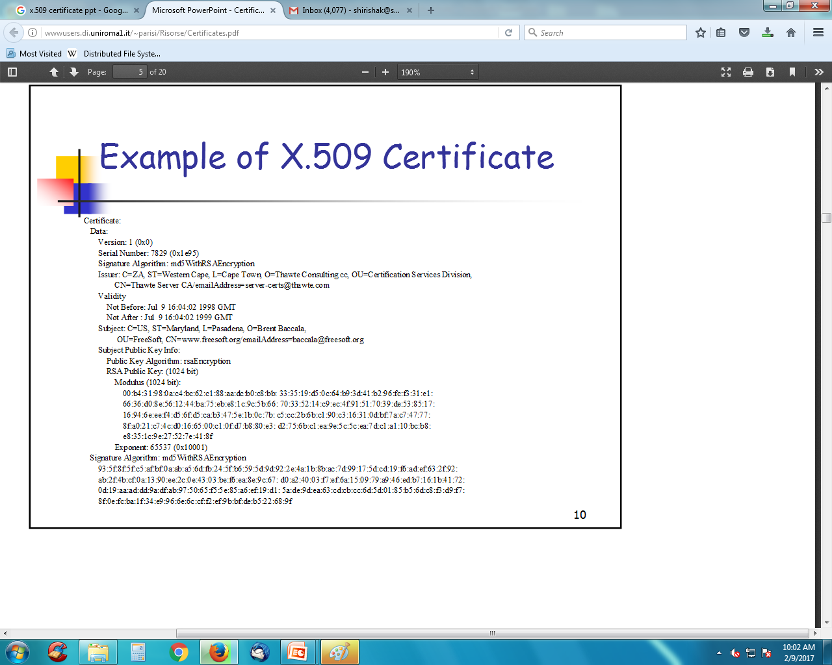
X.509 Certificate Example

Slide 58
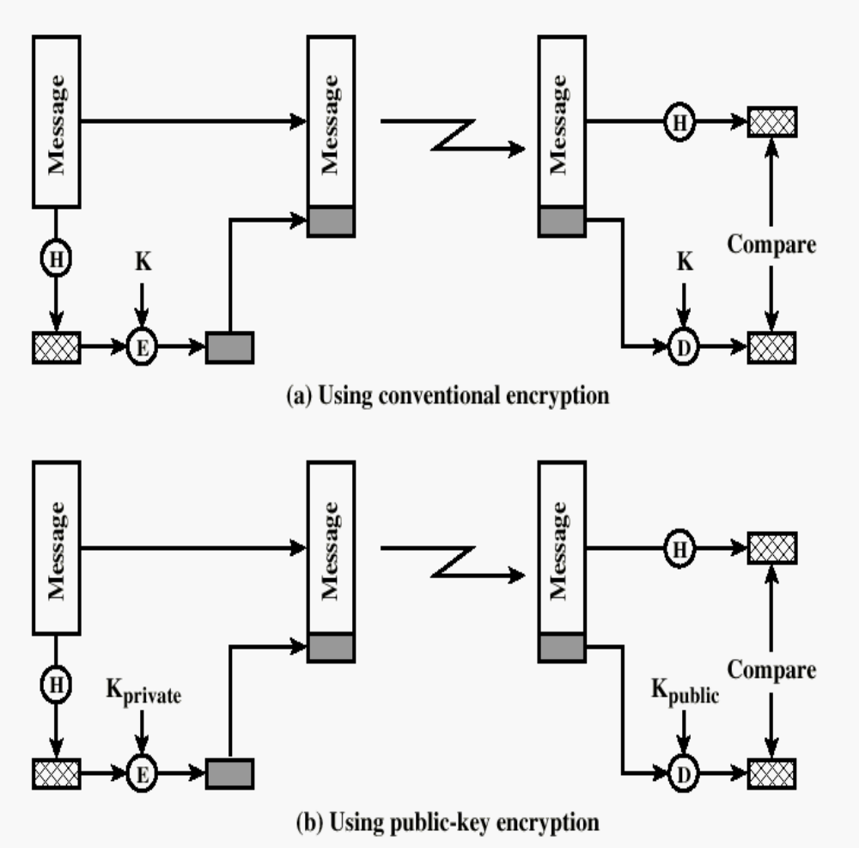
Typical Digital Signature Approach

Slide 59
Obtaining a User’s Certificate
Characteristics of certificates generated by CA:
  Any user with access to the public key of the CA can verify the user public key that was certified.
  No party other than the CA can modify the certificate without this being detected.

Slide 60
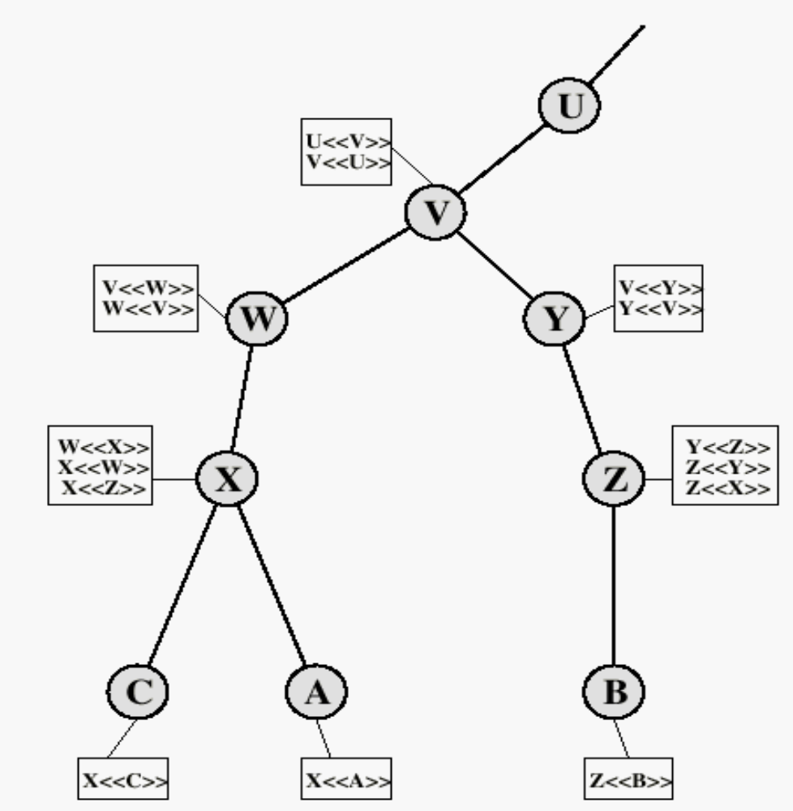
X.509 CA Hierarchy
User A acquires following certificates from the directory to establish certification path to user B:
X<<W>>W<<V>>V<<Y>>Y<<Z>>Z<<B>>

Slide 61
Authentication Procedures
X.509 includes three alternative authentication procedures:
One-Way Authentication
Two-Way Authentication
Three-Way Authentication
all use public-key signatures
Notes:
The X.509 standard specifies the authentication protocols that can be used when obtaining and using certificates. 1-way for unidirectional messages (like email), 2-way for interactive sessions when timestamps are used, 3-way for interactive sessions with no need for timestamps (and hence synchronised clocks).

Slide 62
1. One-Way Authentication
1 message ( A->B) used to establish
  the identity of A and that message is from A
  message was intended for B
  integrity & originality of message
message must include timestamp, nonce, B's identity and is signed by A

Slide 63
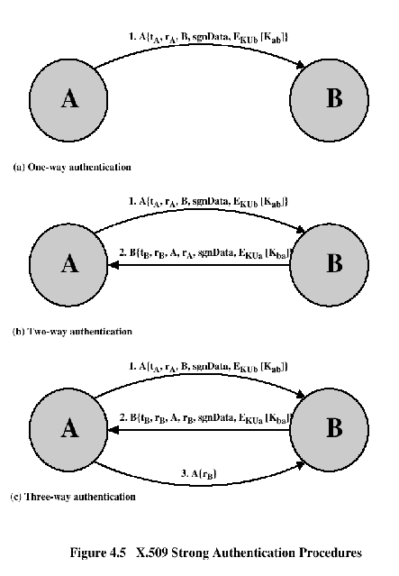
Authentication Procedures

Slide 64
2. Two-Way Authentication
2 messages (A->B, B->A) which also establishes in addition:
  the identity of B and that reply is from B
  that reply is intended for A
  integrity & originality of reply
reply includes original nonce from A, also timestamp and nonce from B

Slide 65
3. Three-Way Authentication
3 messages (A->B, B->A, A->B) which enables above authentication without synchronized clocks
has reply from A back to B containing signed copy of nonce from B
means that timestamps need not be checked or relied upon

Slide 66
Description of X.509 Version 3
The following requirements not satisfied by version 2:-
Subject field is inadequate to convey the identity of a key owner.
The subject field is also inadequate for many applications
There is need to indicate security policy information
There is a need to specify particular public key among several public keys of same CA or user
Need to specify constraints on the applicability of a particular certificate

Slide 67
Version 3 includes “extension” field, which is optional. The certificate extensions fall into three main categories.
    (1) Key and policy information
    (2) Subject and issuer attributes
    (3) Certification path constraints
(1) Key and policy information:
    i) Authority key identifier
    ii)Subject key identifier
    iii)key usage
    iv) private key usage period
    v) certificate policies
    vi) policy mappings

Slide 68
(2) Subject and Issuer attributes:
        (I) Subject alternative name
        (ii) Issuer alternative name
        (iii) Subject directory attribute
(3) Certification path constraints:
    (I) Basic constraints: If subject is CA, then certification path length constraint may be specified.
    (ii) Name constraints
    (iii) Policy constraints: Inhibit policy mapping for the remainder of the certification path

Slide 69
Revocation of Certificates
Reasons for revocation:
  The users secret key is assumed to be compromised.
  The user is no longer certified by this CA.
  The CA’s certificate is assumed to be compromised.

